Slide 1
Introduction to Open Source Workshop
Lets Dive into the Devs Community

Slide 2
Know Me
Pratham Rasal
Smart India Hackathon 2022 Winner |
Co-founder @ Verved| CTO @ Arch Labs |
Full Stack Developer (MERN) | AI / ML
Enthusiast | Competitive Coder
Notes:
Hi Guyzz Iam Pratham Rasal from CS 4th Year. I’ve been working in the industry from last two years building startup working for startups, Currently being a founding member and Technical Head @ Agrivision 4U which now cross the valuation of 10Cr. There are various experience I can share with u guyz about hackathons I have won how to acqire experience and how to not do what everyone is doing..

Slide 3

01
What is Open Source?
The source which is open.

Slide 4
Introduction
Open-source software is computer software that is released under a license in which the copyright holder grants users the rights to use, study, change, and distribute the software and its source code to anyone and for any purpose. Open-source software may be developed in a collaborative, public manner.
Key Characteristics:
It’s free to use
The source code is accessible
Developers are free to modify the source code for their own purposes, including for commercial use

Slide 5
Make Your First Open Source Contribution
01
02
03
04
Pick a project
Find a good first issue
Check project requirements
Submit a pull request

Slide 6

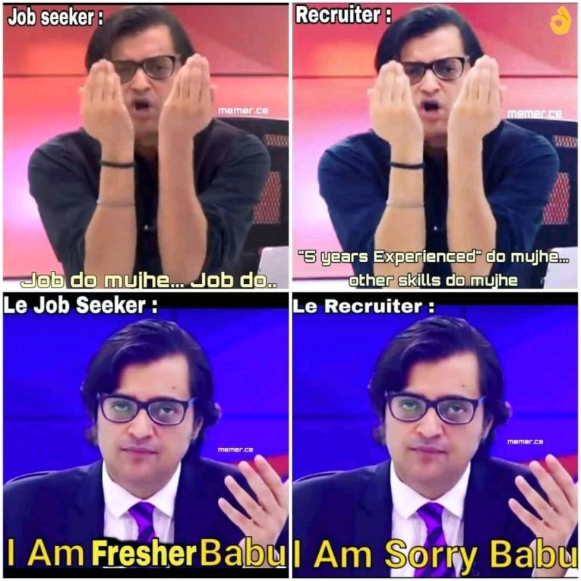
Job Opportunities

Slide 7





MUST HAVE…
Patience
Skills
Projects
Work
Experience
Communication

Slide 8
Preperation Strategies
Computer Fundamentals
Top MNCs
CP/DSA
Slow And Steady Learning Curve
Companies
Development Skills
Startups
Communication
Fast Paced Environment with More Learnings

Slide 9
How to Apply?
Use LinkedIn and Make Connections with Technical Recruiters and Employees of the company you want to apply.
Constantly check for the openings which corresponds to your skills and experience
Ask for referrals for the open vacancies
Apply using Referral links.
Prepare a Good Resume and Cover Letter.
Wait For the Response
Prepare for Interviews according to the Job Description

Slide 10
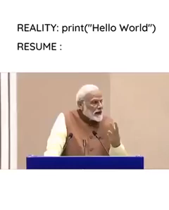
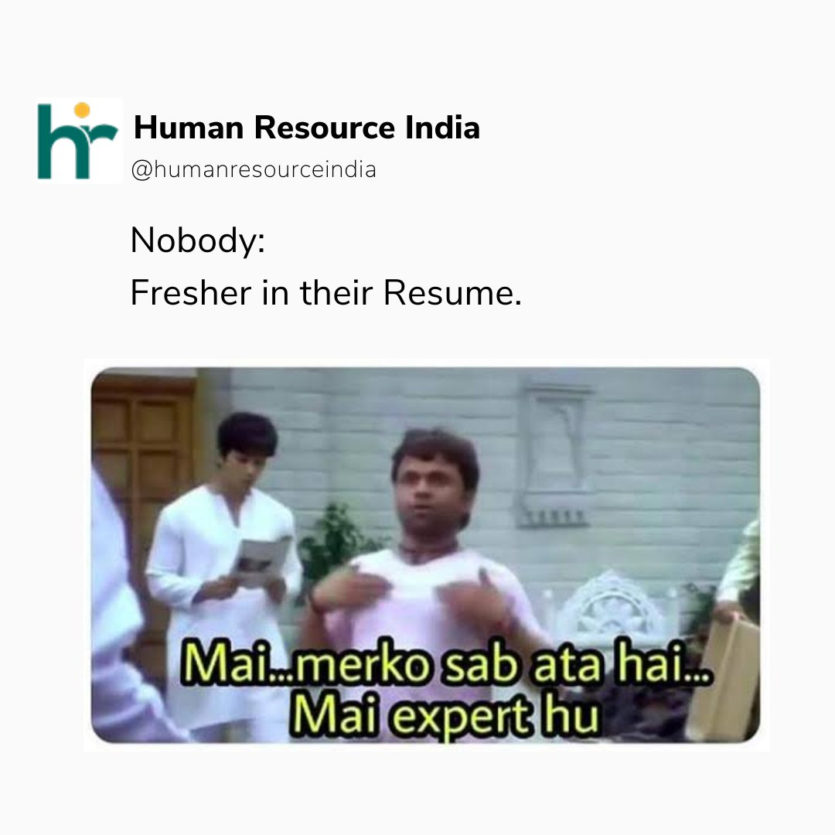
Resume Building

Slide 11

Purpose
Obtain interview
Showcase your KSAOs, experience, and accomplishments
KSAOs: knowledge, skills, abilities, and other characteristics

Slide 12
Key Points
DO NOT USE MICROSOFT WORD FOR BUILDING RESUMEE… (Most Important)
Use Overleaf or any other latex code platform for building resume.
Give Time on your Resume. Do not lie in your resume.
Quantify your achievements.
Do not write objectives/summary until said in Job Description.
Do not write unnecessary or irrelevant extra curriculars like playing cricket and all in resume.

Slide 13
ATS Optimised Resume (Most Important Takeaway)

Slide 14

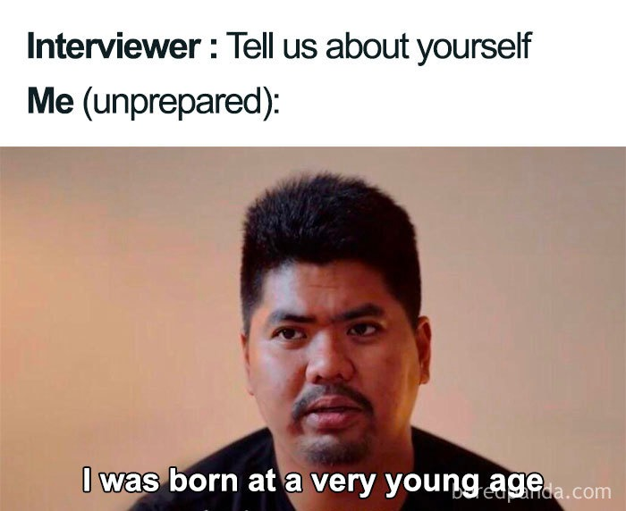
What not to do!!!

Slide 15
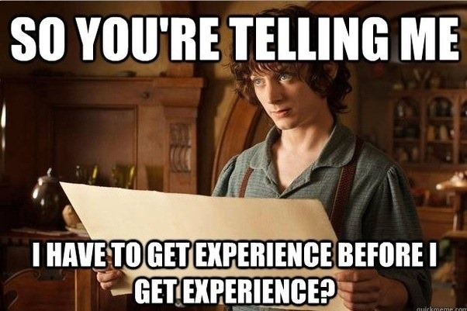
Industry Experience

Slide 16
How to get Experience?
Internships
Open Source
Freelance
Build your Startups

Slide 17
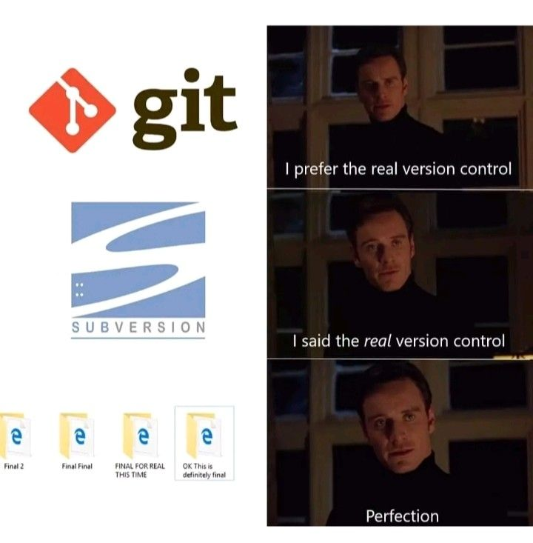
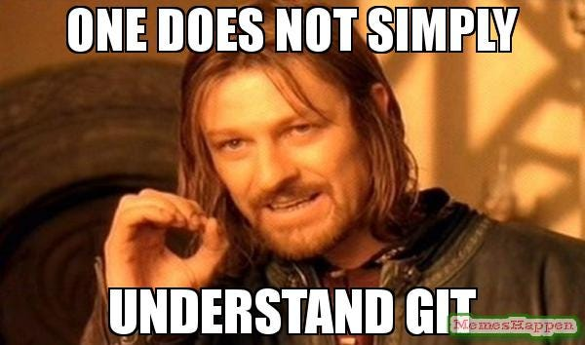
Git / Github

Slide 18
Intro to Version Control
Git: An Open Source Distributed Version Control System
Purpose: Helps developers track changes and collaborate in coding
Git's Role:
Efficient tracking of changes
Conflict prevention
Time-saving code management
Git in Team Collaboration: Facilitates seamless collaboration
Git in Emergency Situations:
Fast recovery and rollback
Critical in crisis management

Slide 19
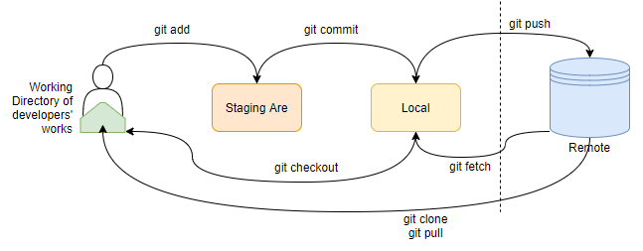
Git Flow

Slide 20
Getting Started With Git
git clone <url-repository>
git remote add origin <url-repository>
git remote remove origin <url-repository>
git add <files-to-add>
git commit -m <comment messages>
git push origin master — force
git checkout <branch-name>
git checkout -b <branch-name>
git pull

Slide 21
Hands on Git Github

Slide 22

Use Cases
Code Hosting and Version Control
Collaborative Software Development
Issue Tracking and Project Management
Continuous Integration and Deployment (CI/CD)
Community and Open Source

Slide 23
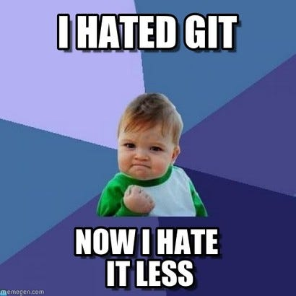

Slide 24

Thank You

